Slide 1

International Economic of New Zealand
The impact of COVID-19 on the New Zealand economy
Member
Yuting Zhang
Yuhao Huang
PingYuan MA
DATA201 Group Project

Slide 2
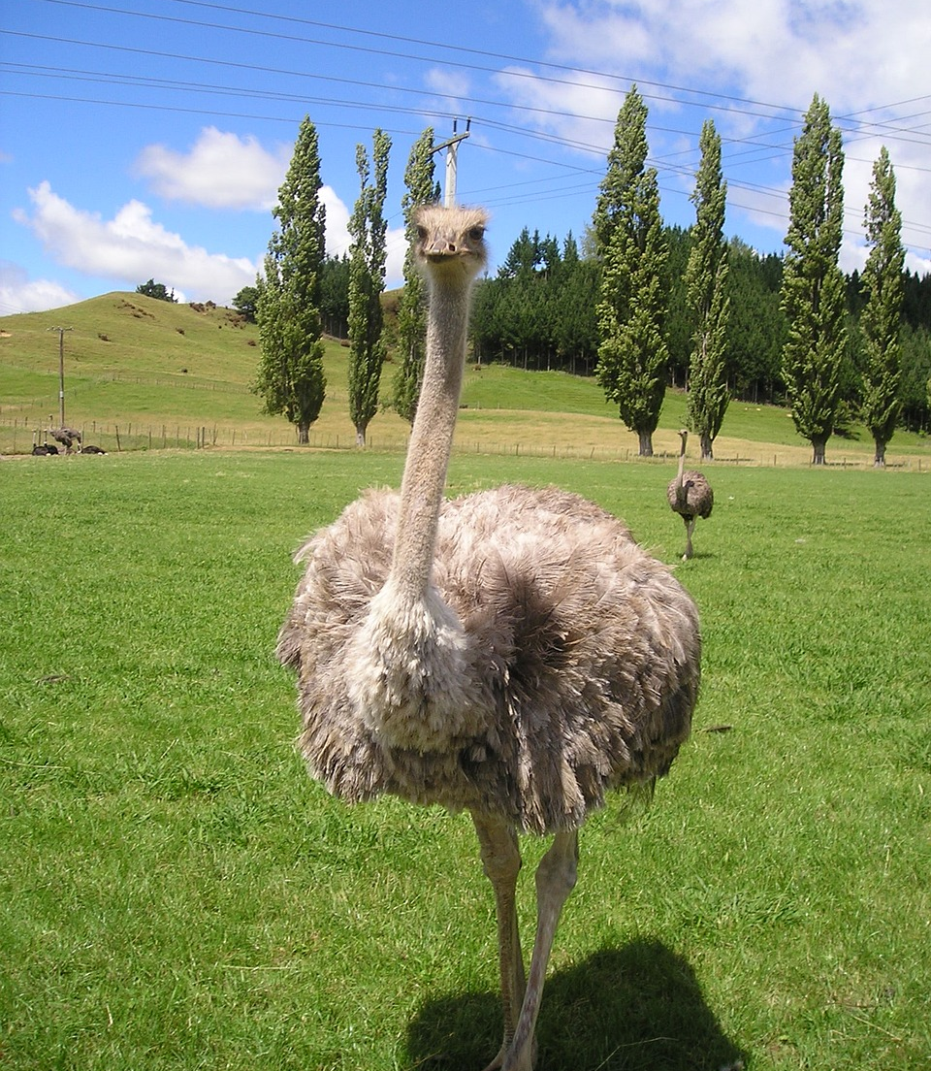


Introduction
International Travel
International tuition Fee
Overseas Merchandise Trade
Economic Impact
Notes:
The COVID-19 outbreak that erupted at the end of 2019 has a profound impact on the global economy. As a part of the world system, New Zealand has also been affected. We plan to approach this issue from three perspectives, collecting and organizing data to study the economic changes in New Zealand before and after the pandemic.

Slide 3
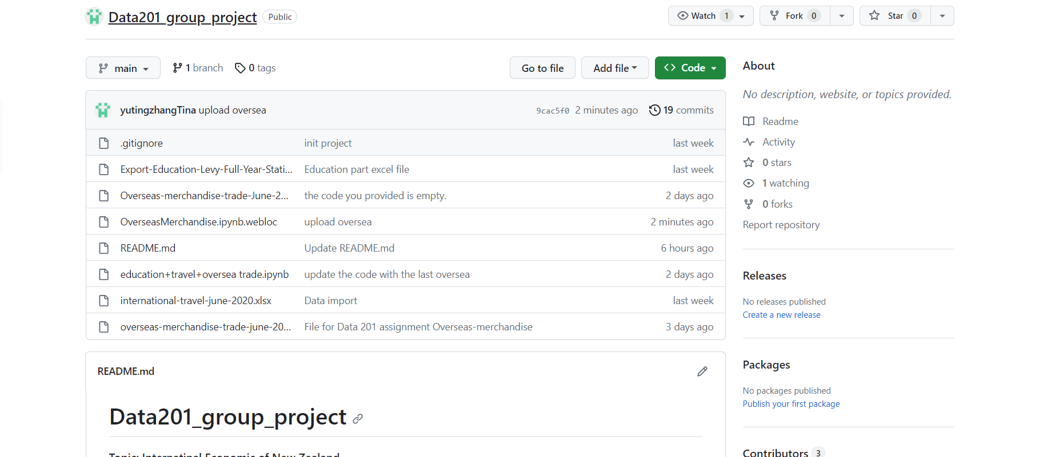
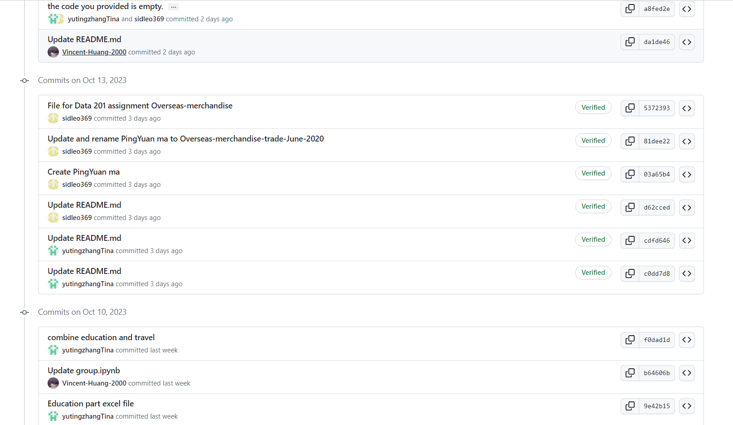


Project Management
We chose GitHub and Trello as our project management tools.
Version Control and Collaboration
Transparency and Traceability
Flexible Project Management
Access Control and Security
Notes:
In this data analysis project, we chose GitHub and Trello as our project management tools.
These two tools help us easily track each code change, ensure data integrity and stability, and promote communication and collaboration among the team.

Slide 4
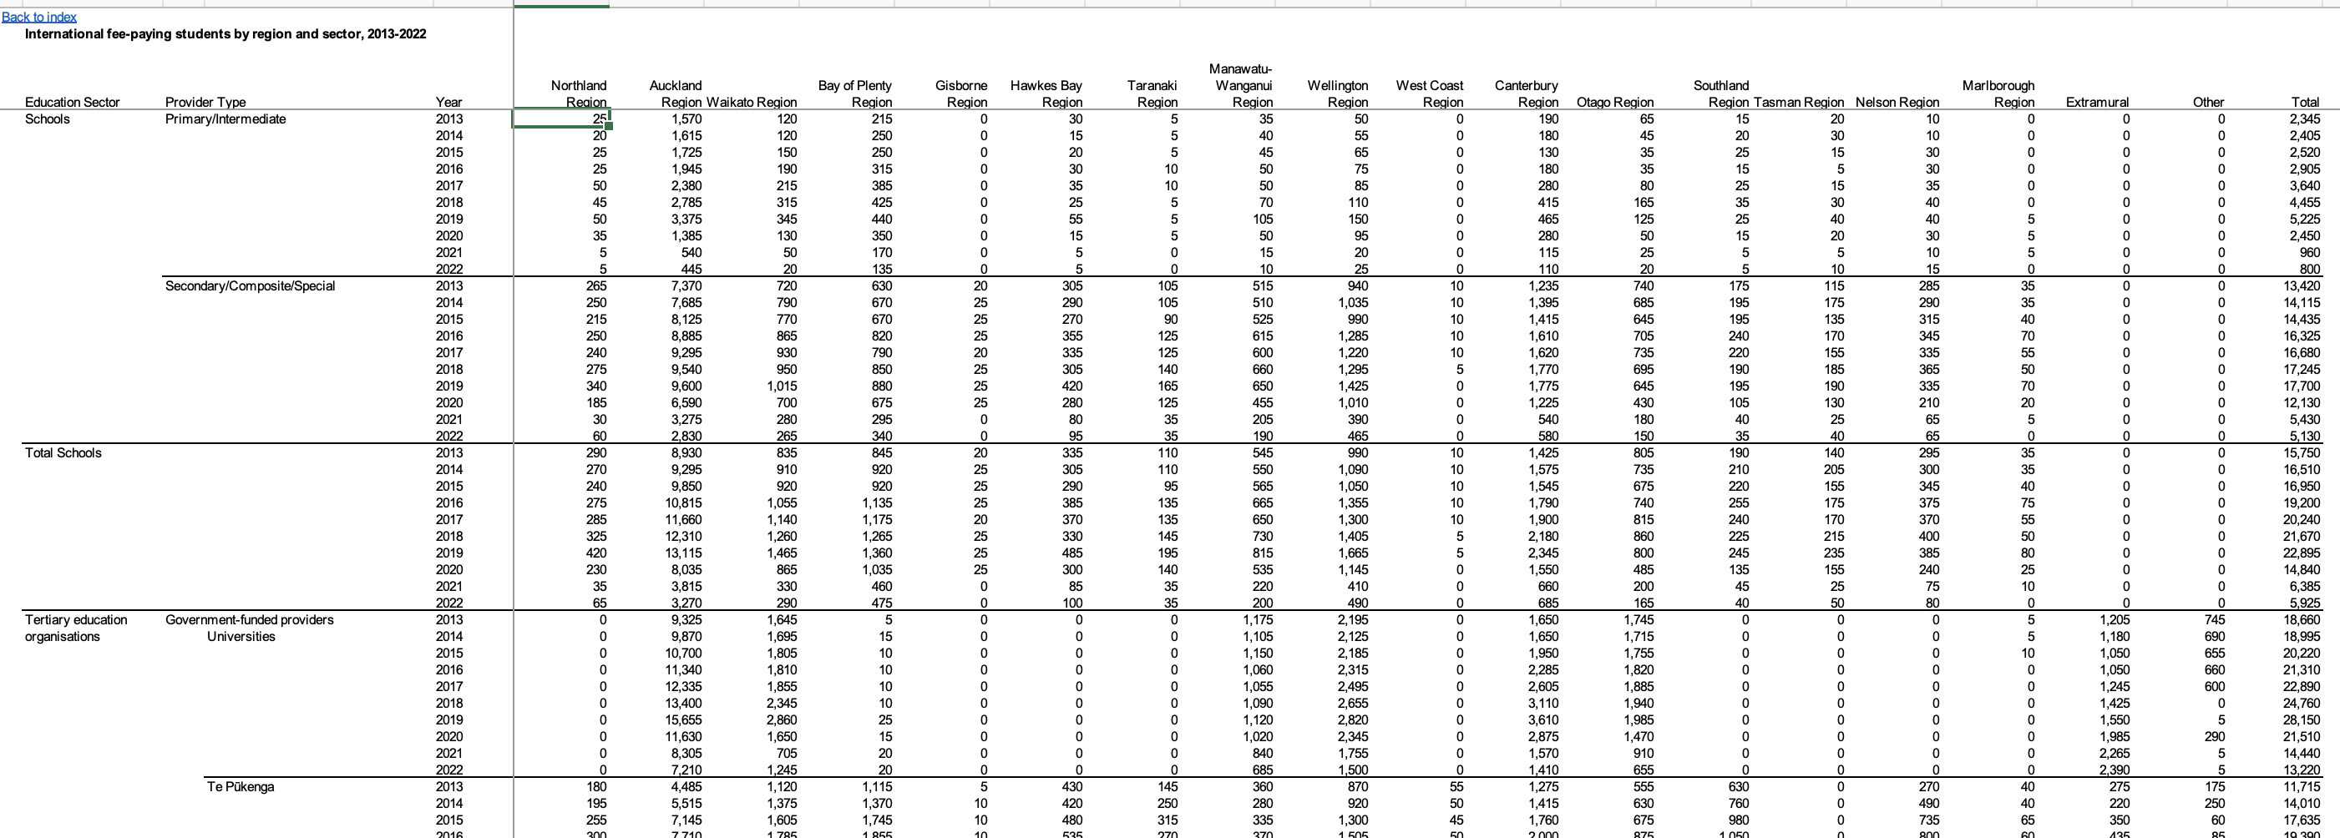
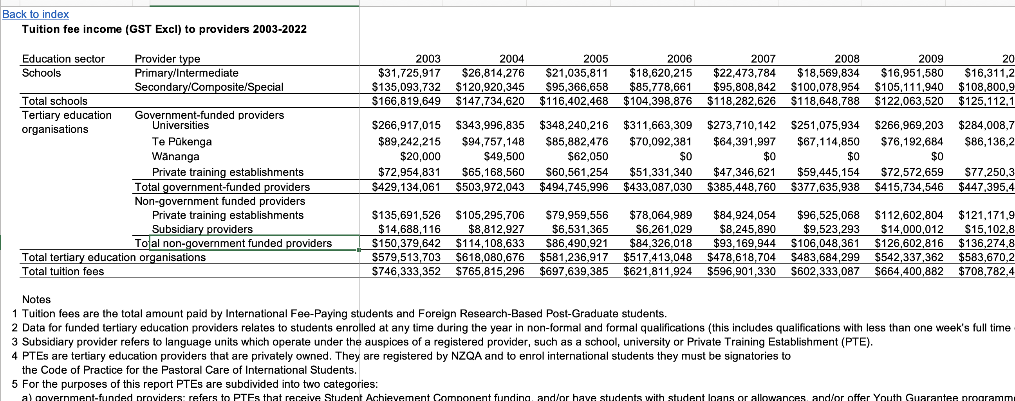
International Tuition Fee
Data Sources
International students in New Zealand
https://catalogue.data.govt.nz/dataset/international-students-studying-in-new-zealand
Notes:
This my data sources which from the govt.nz website ,The original data sources is a excle file it look like that

Slide 5

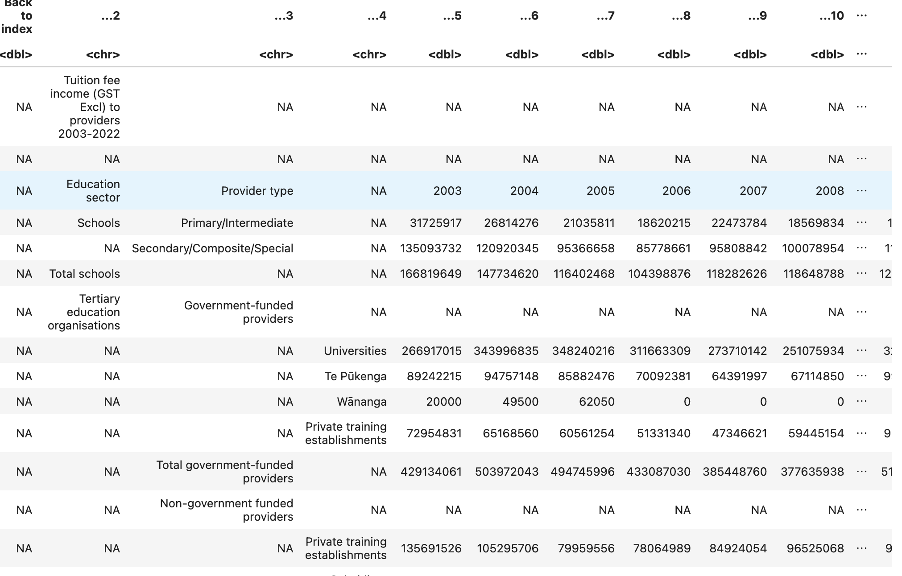
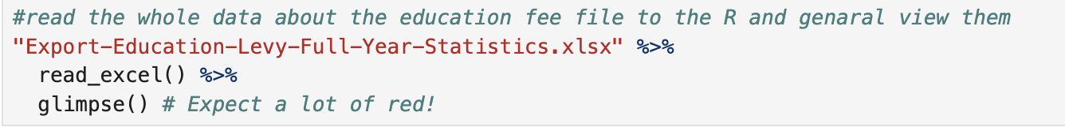
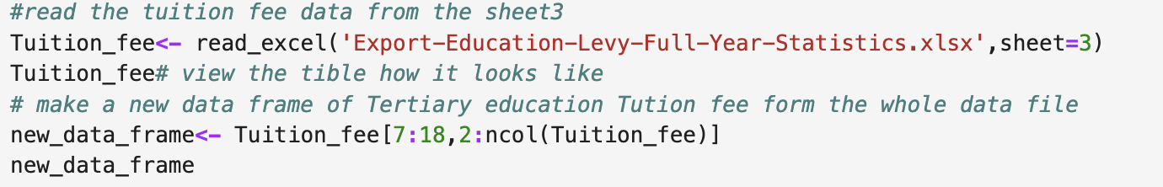
Difficult &Solve
There are some NA were introduced
import the data from excel the column name has been garbled.
Notes:
I first input the spreadsheet 3 which about the Tertiary education fee of NZ categrie by government funded and non funded from the entire excel into Jupyter lab. we can see that there is some useless information like NA were introduced and also the columns name were disappear. so I need to rename them and omit the NA that can make the data more clean and more easier to Visualization by "ggplot"

Slide 6
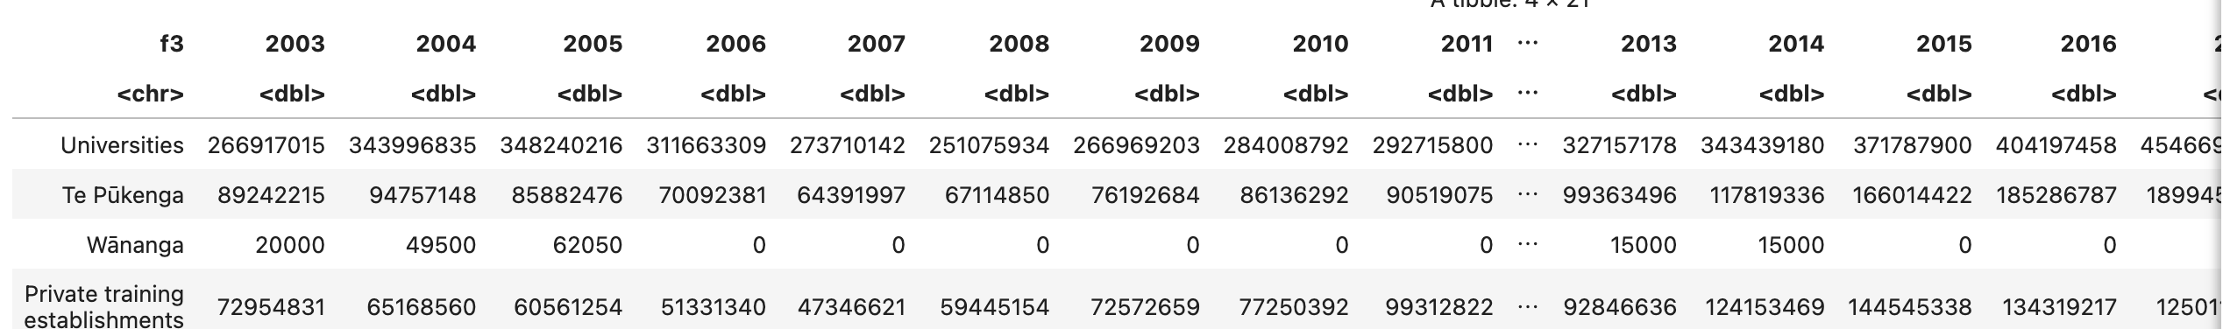
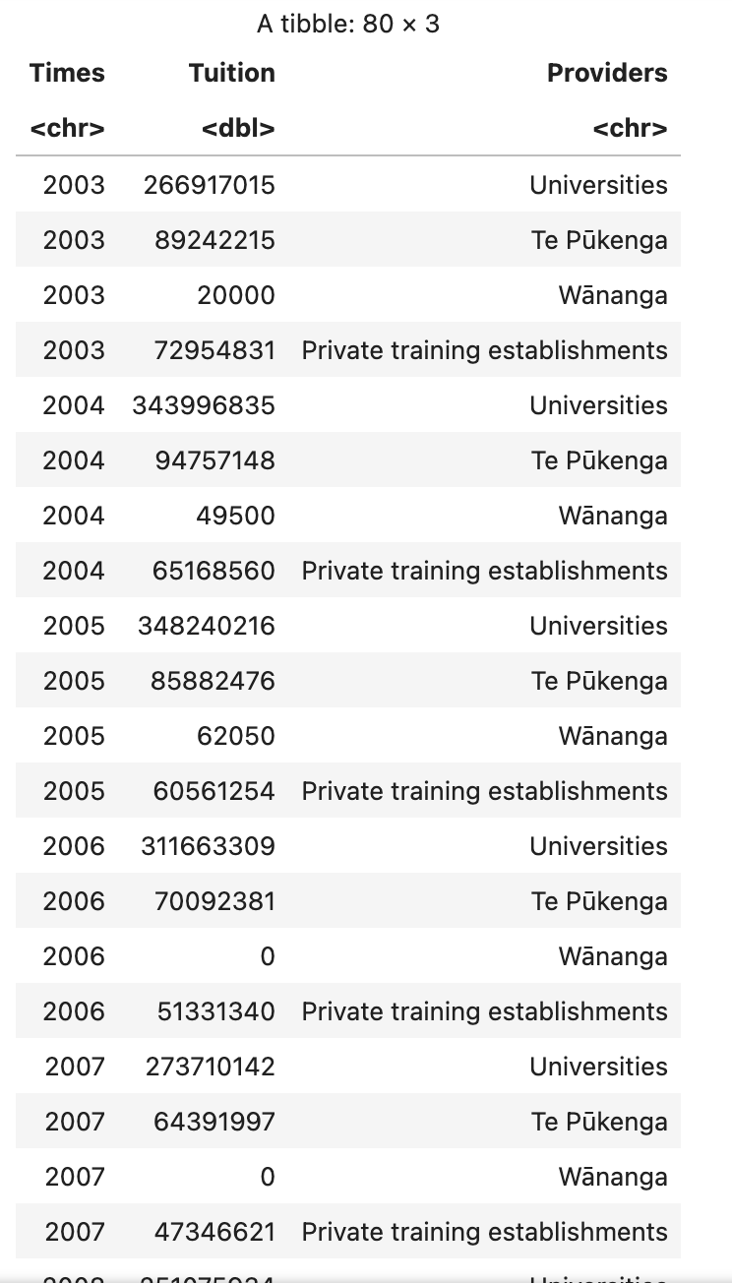
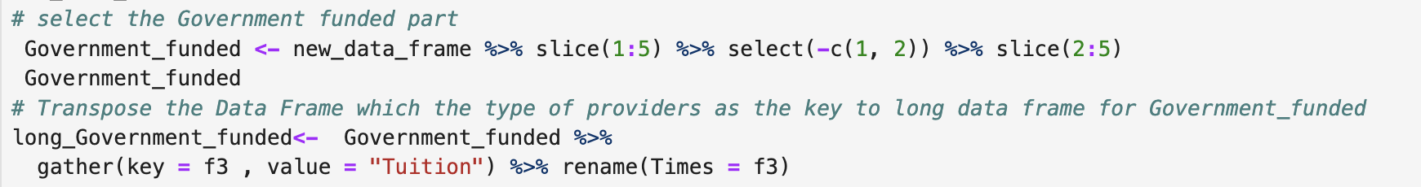
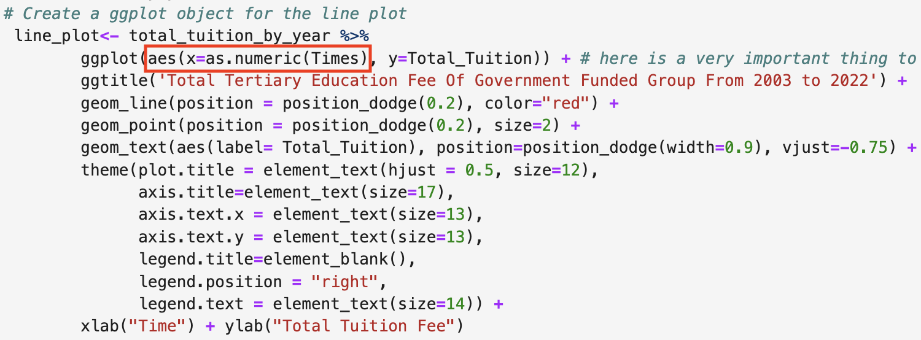
transform the wide data frame to the long
Change the column of Times from characters to numeric
Notes:
After select and clean I got a wide tibble but it still not suitable for polt, The point is find the a suitable "Key" to transform it to a long Tibble and here I select the first colum "f3" which is the provides , I name it later. If we wanted to show them on a time scale, we would repeat provide 10 times because we know that one provider corresponds to one tuition income per year
And anoter very importsnt thing is need to change the collum of "Times" from Characters to numeric
Because the trend line can not be show in the plot when the variable of the x-axis is characters

Slide 7
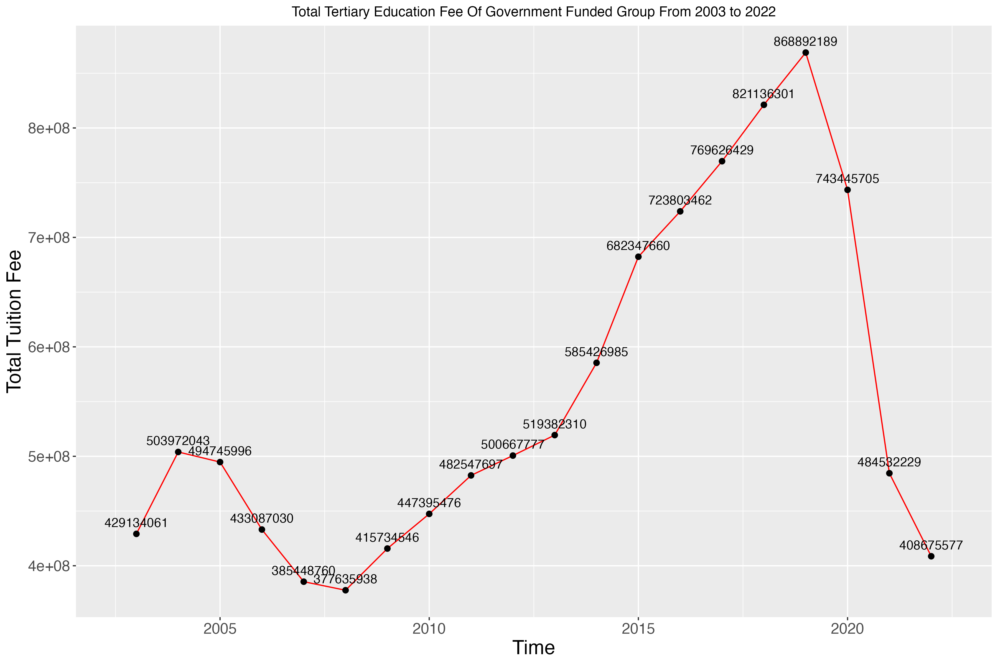
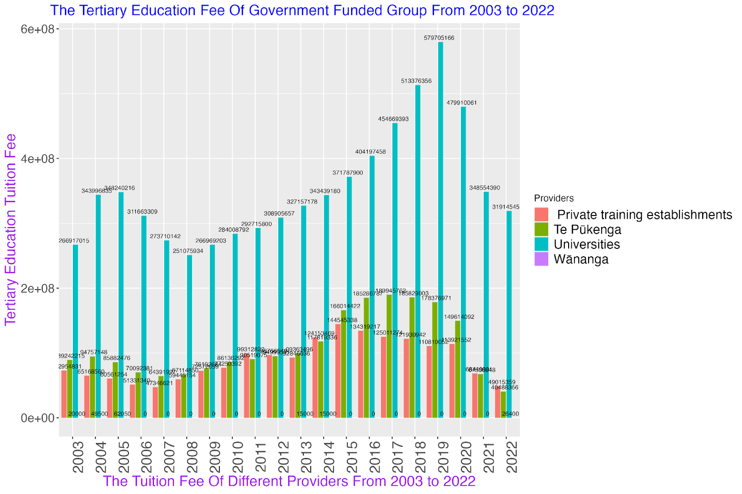
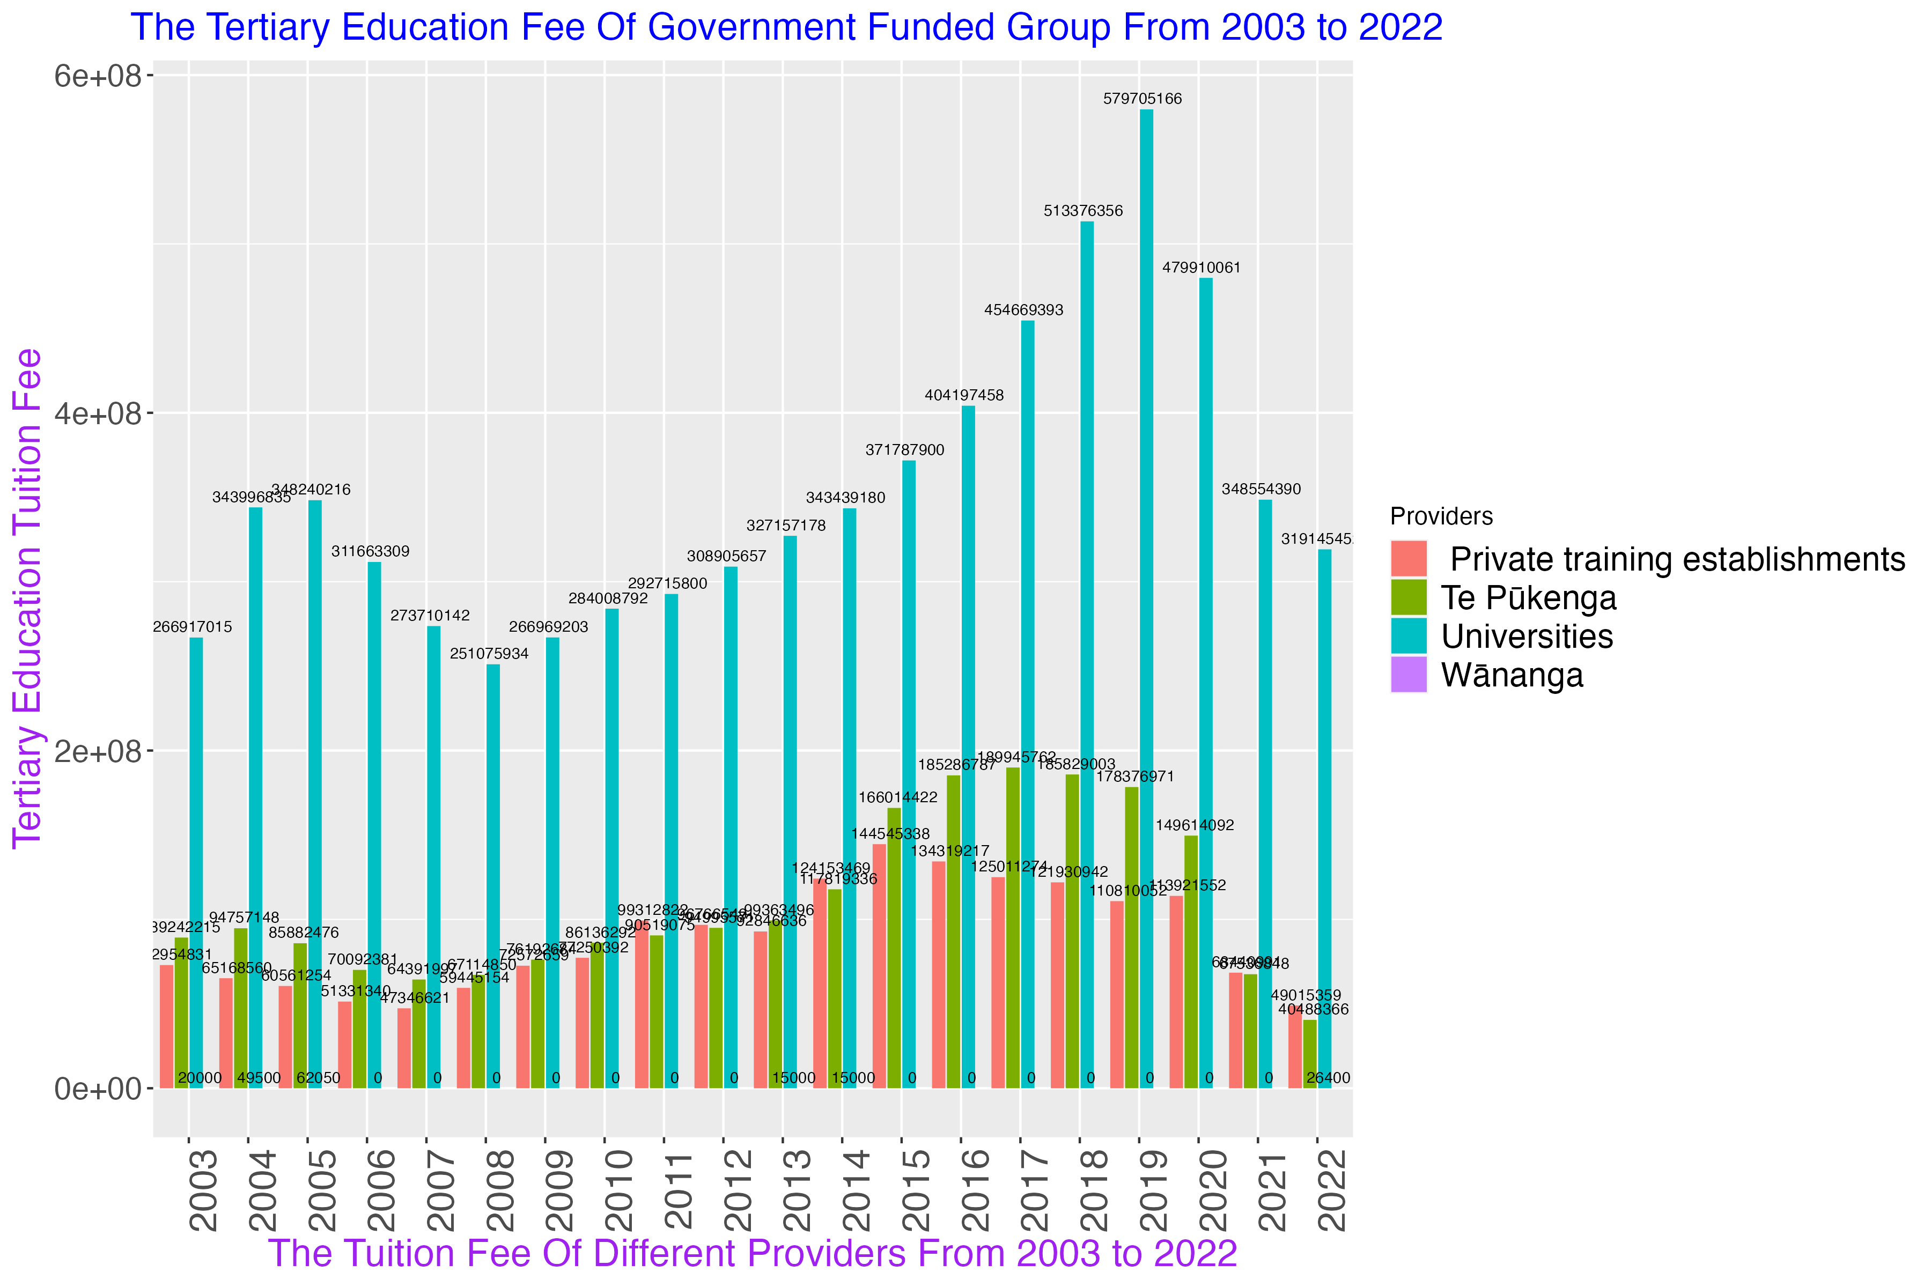
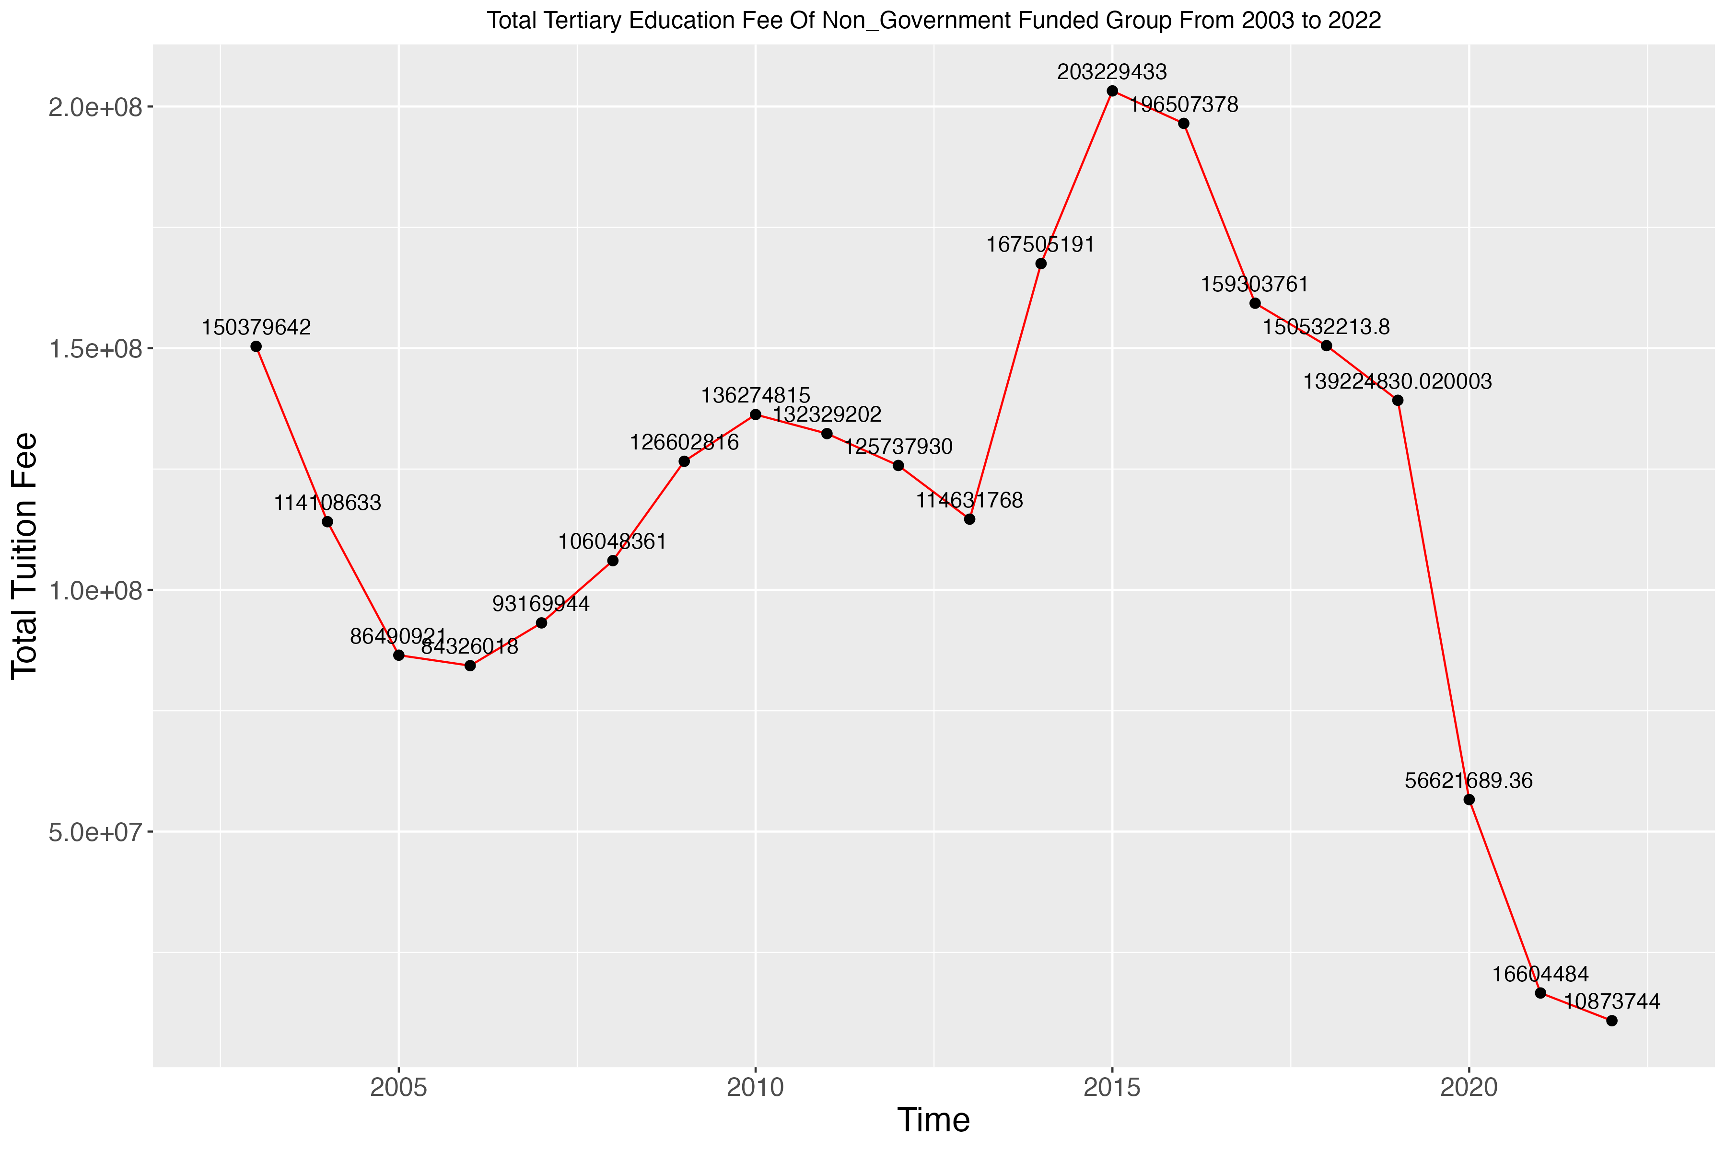
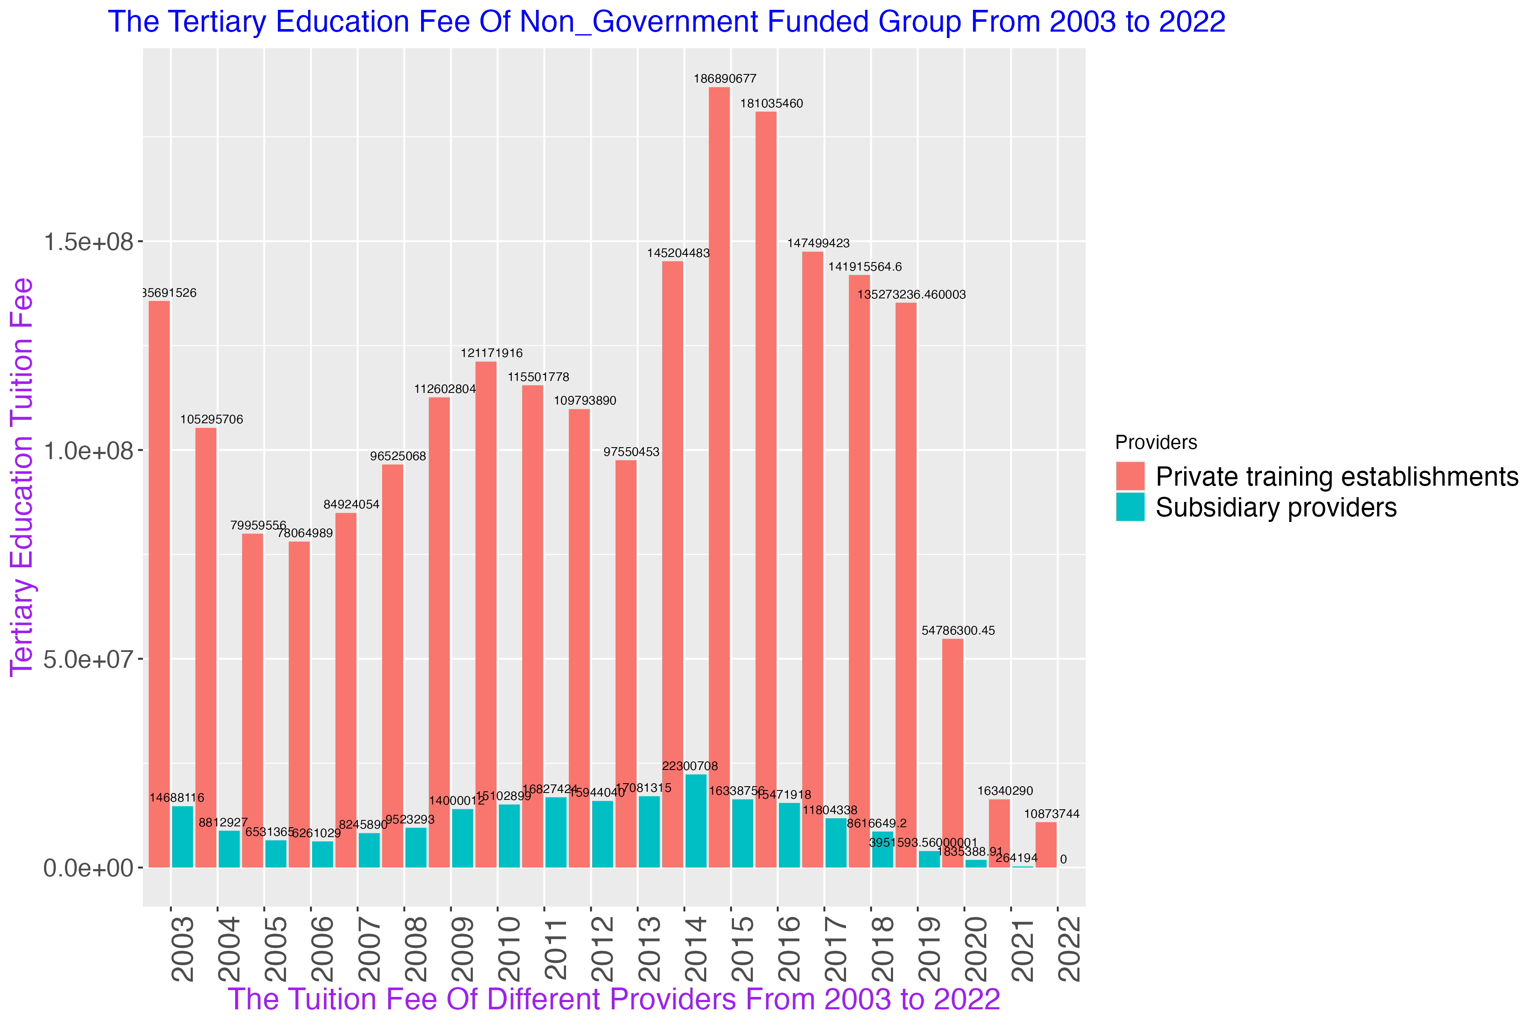
Result
Notes:
From the graph we can see that the education fee of government funded, and nongovernment funded providers both have a huge declined from 2019 to 2020

Slide 8
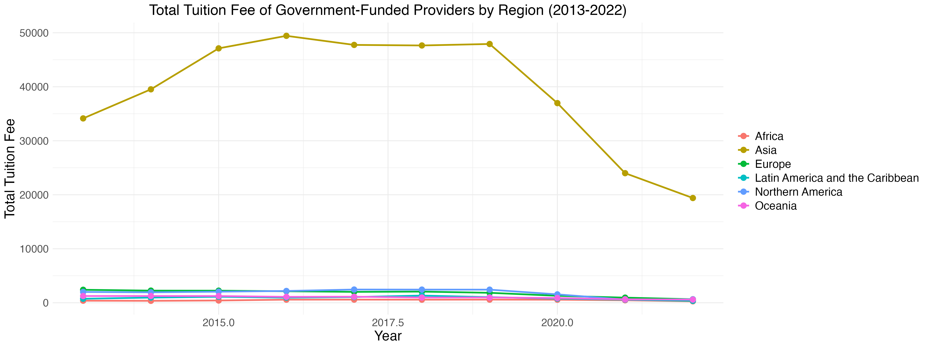
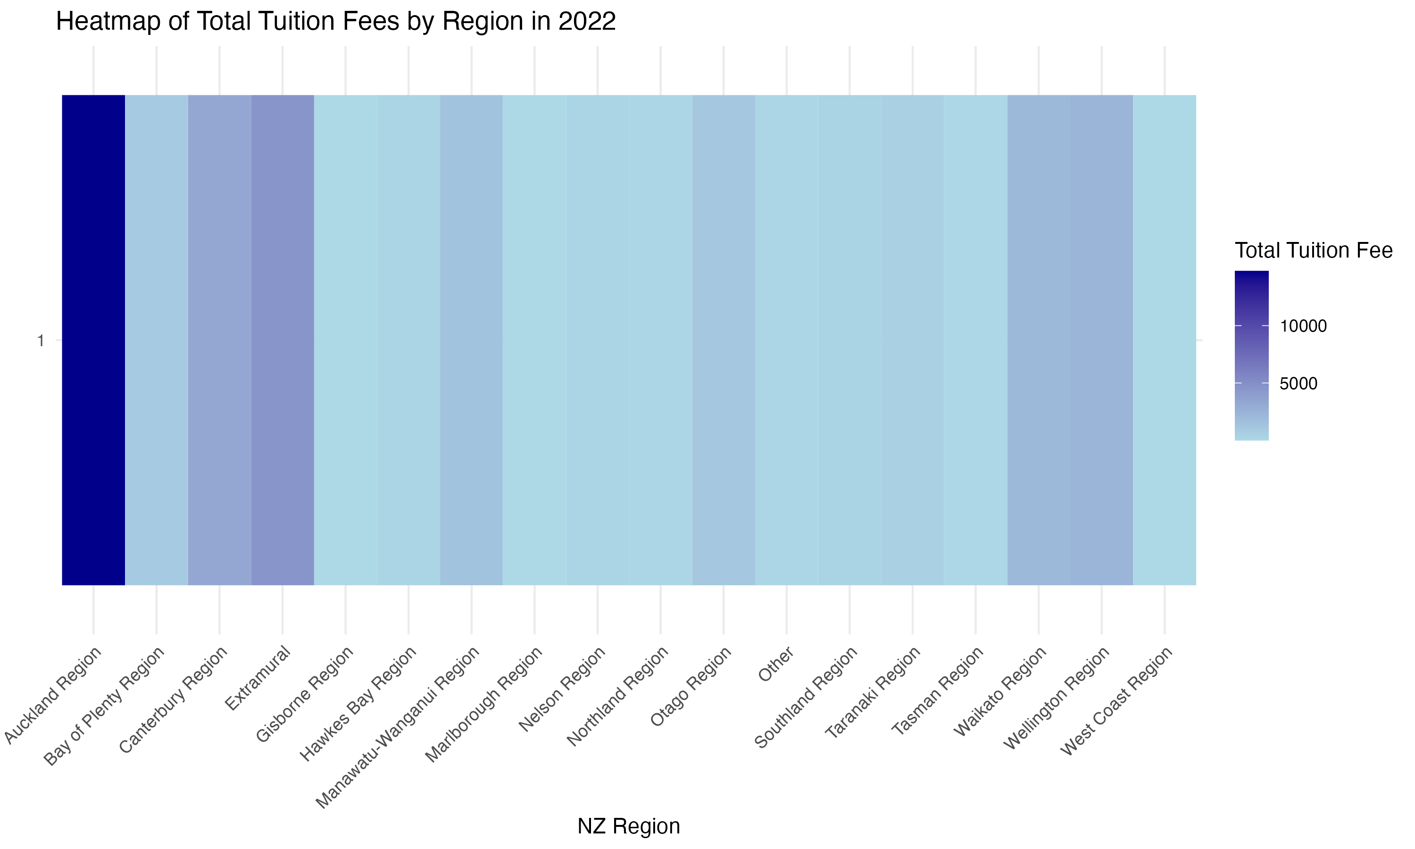
Result
Notes:
And also , over here the other plots I got at the left hand side is about the tuitions fee from different regions we can know that the largest contributor is Asia
In the picture on the right, I have specifically selected a heat map of tuition fees in different regions of New Zealand in 2022.
We can also clearly see that Auckland is the region with the highest income.

Slide 9
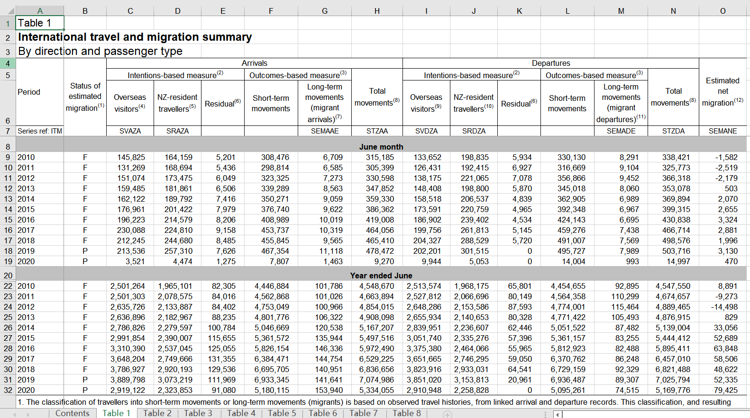
International travel and migration summary​
By direction and passenger type​
Dataset source:
https://catalogue.data.govt.nz/dataset/international-travel
Notes:
This is the section I analyzed, focusing on International Travel and Migration, with data sourced from Stats NZ.
The data is in an Excel file, so some processing is needed.

Slide 10
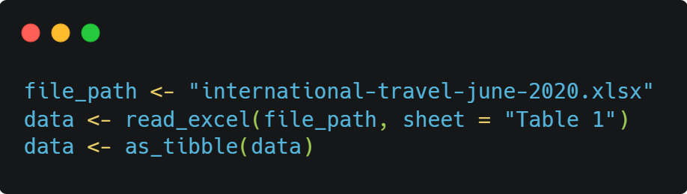
Read the excel file
Convert the data into tibble format
Notes:
So I used the read_excel function to extract data from the file,
and as_tibble function to convert the data into a tibble format.

Slide 11
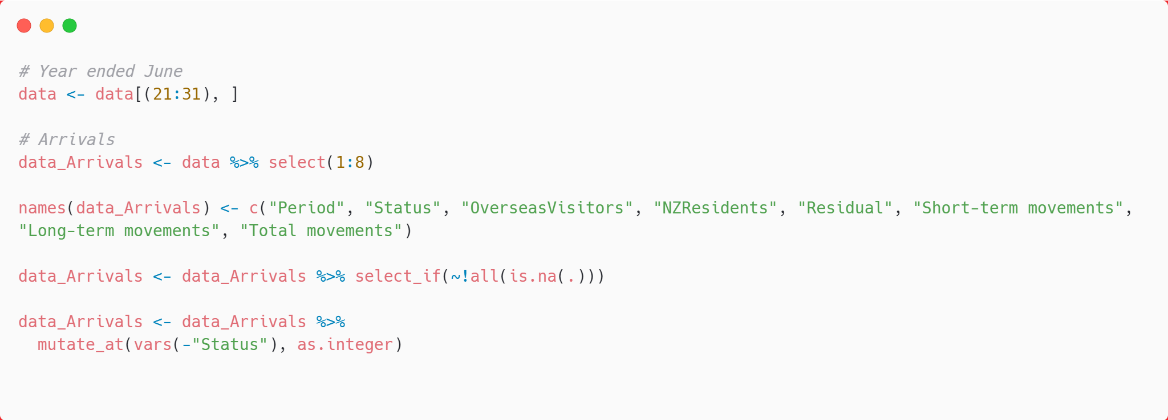
Data Processing
Next, I did some processing on the data and gave the columns appropriate names. At the same time, the number represented by the string is converted into an integer.
Notes:
After that, I did some data cleaning, like giving each column the suitable name,
and changing the data to integer.

Slide 12
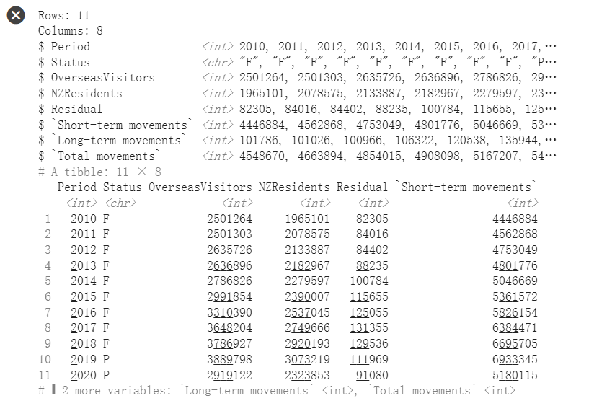
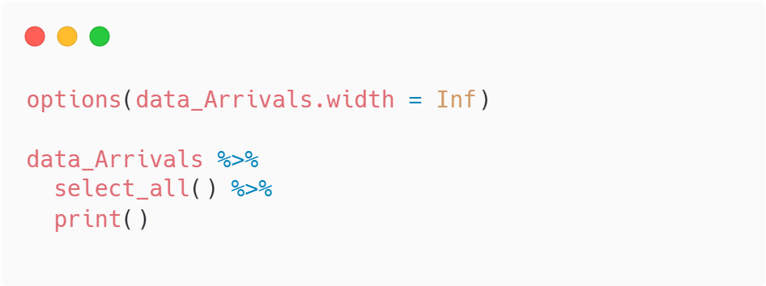
Data Processing
Notes:
This is my processed data.

Slide 13
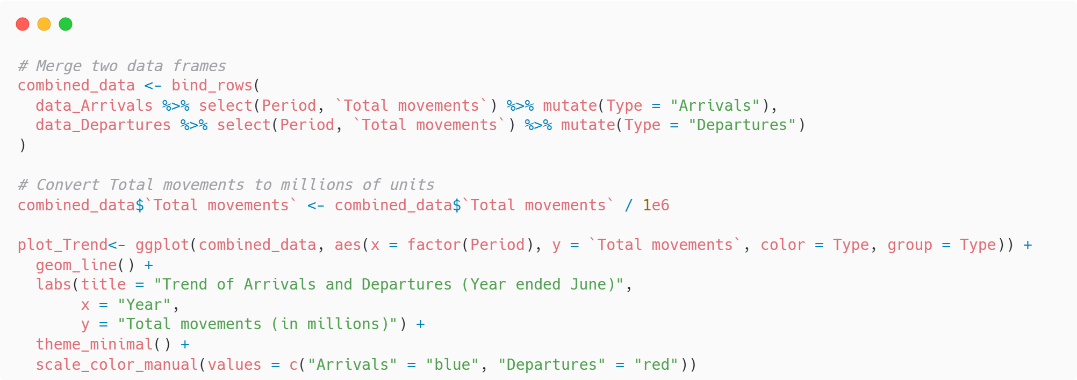
Graph
Notes:
To create the chart, I merged two tables in tibble format.

Slide 14
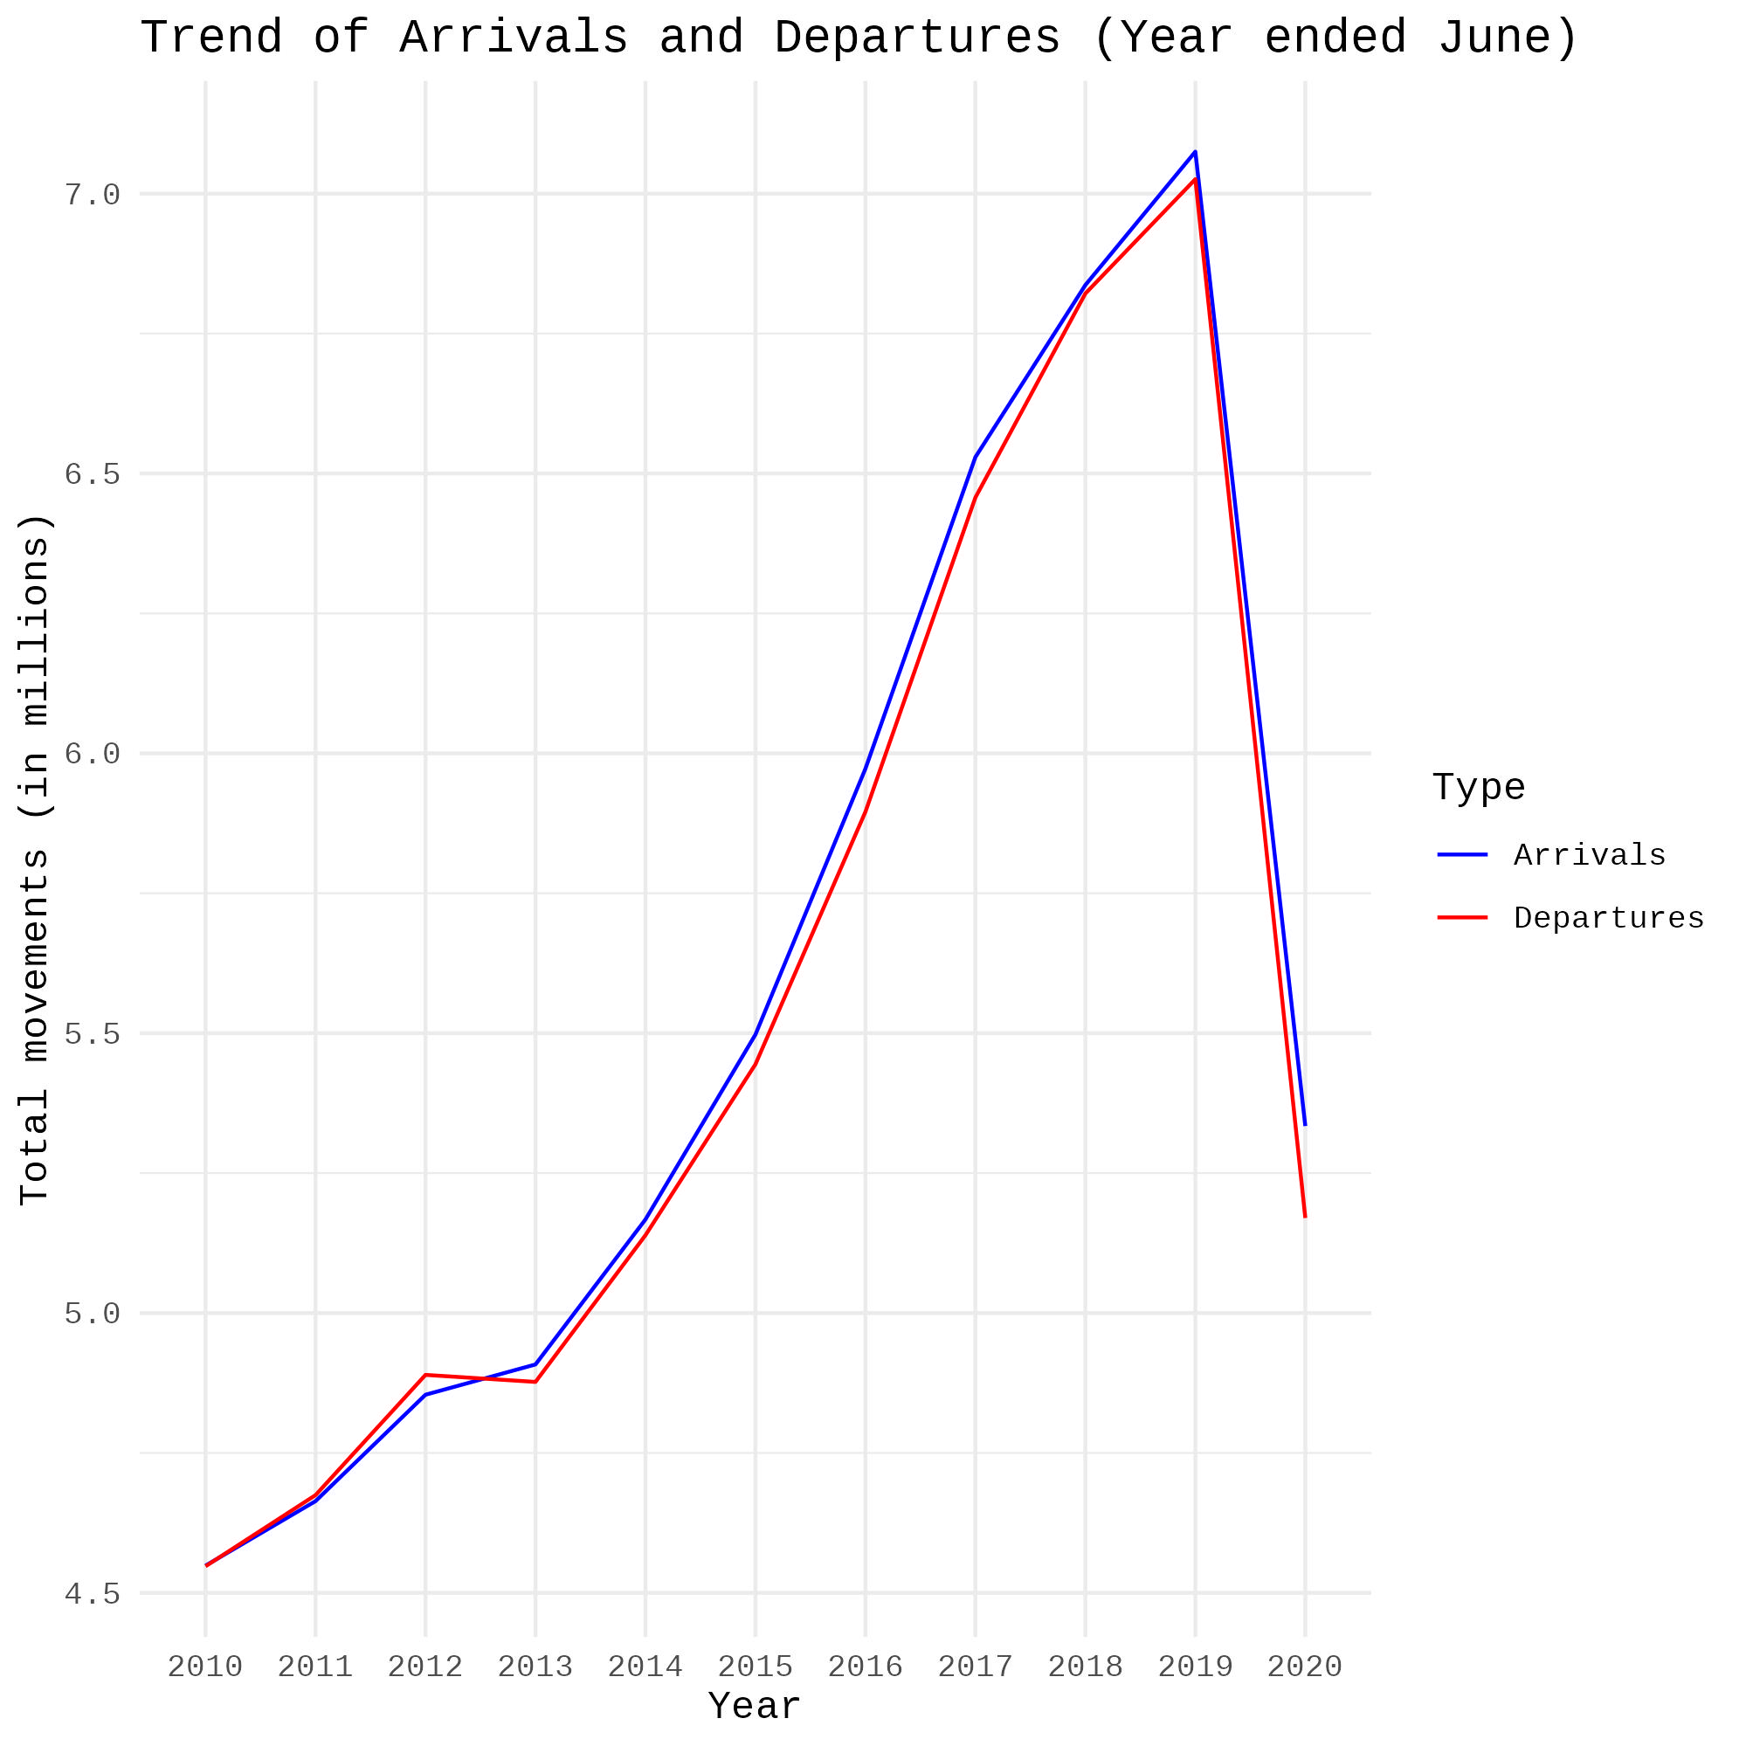
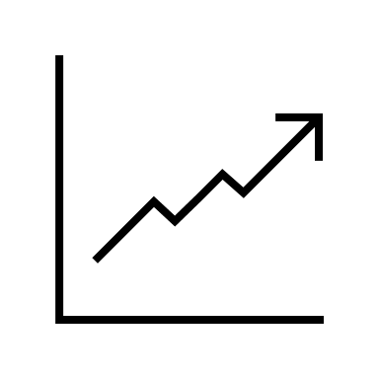
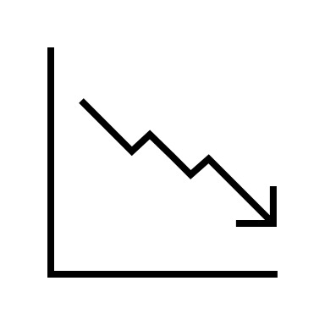
Trend of Arrivals and Departures (2010-2019)
2010-2019
2019-2020
Notes:
Here's the final chart. You can see from 2010 to 2019, both arrivals and departures are going up steadily.
This shows New Zealand's tourism and economy were doing well during this time.
But after 2018, the number of people leaving dropped a lot, and by 2019 and 2020, it dropped very quickly. This matches up with when COVID-19 hit, which is likely the big reason for the drop in arrivals and departures in the chart.

Slide 15
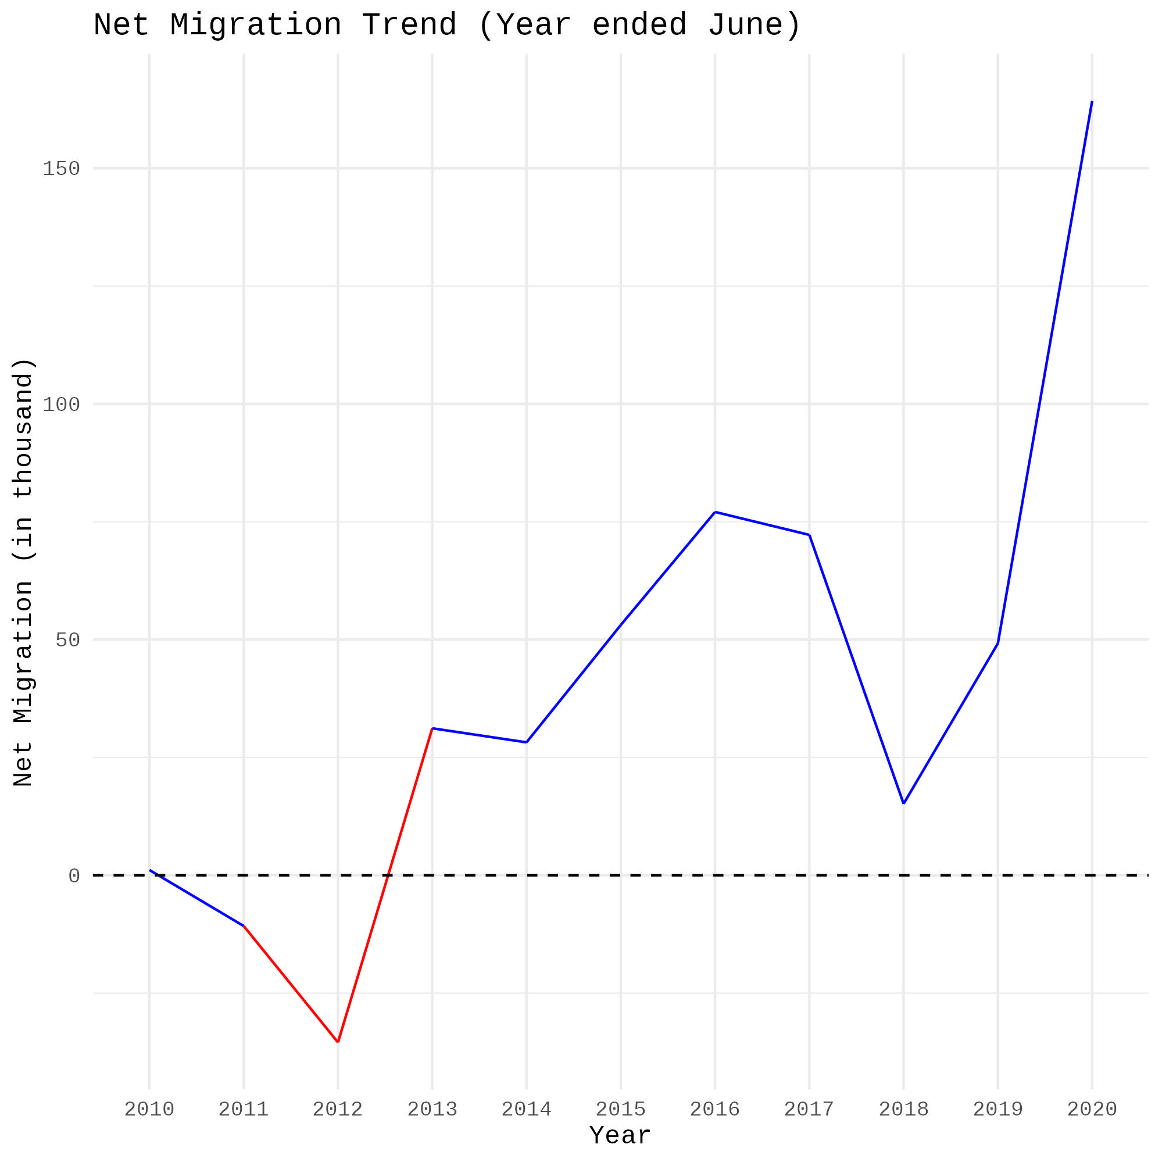
Net Migration Trend (2010-2019)
The net difference between the total number of people entering and leaving New Zealand, including travelers and immigrants.
The red line represents a negative net migration, meaning more people arrived than immigrated;
the blue line represents a positive net migration, meaning more people immigrated than emigrated.
Notes:
The net difference between the total number of people entering and leaving New Zealand.
We can see from 2011 to 2013, more people left New Zealand than came in. This implies a population loss in New Zealand during this period. A more pronounced growth trend is observed after 2018.

Slide 16

Overseas Merchandise Trade
Notes:
Hi Everyone, My name is Ping, in my part I will make some digs about the changes in New Zealand's economy before and after the epidemic from the perspective of international trade.

Slide 17

Data Source
Infoshare (www.stats.govt.nz/infoshare).
To access overseas merchandise trade time series on Infoshare, select the following category from the homepage:
Subject category: Imports and Exports
Published by Stats NZ
24 July 2020
www.stats.govt.nz
Notes:
Here is the address where I obtained my data source. Unfortunately, it only contains data as of July 2020. Most of the follow-up data are based on speculation. This may cause the result of affect our judgement of the conclusion.

Slide 18

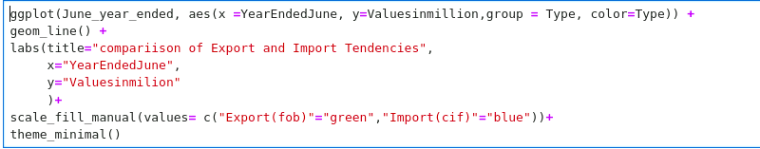
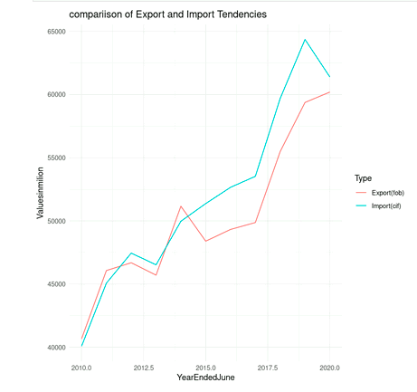
Overseas Merchandise Trade actual value Year Ended June2010-June2020
Notes:
Well, since my team members have introduced the processing of the raw data and the step of generation of tidyverse version for ggplot to read, I will skip that part to save a bit of time. This diagram dedicated the data of New Zealand's import and export volume from 2010 to June 2020. From the picture, we can clearly observe that the import and export transaction volume at the end of 2019 when the epidemic broke out showed a significant declined.

Slide 19

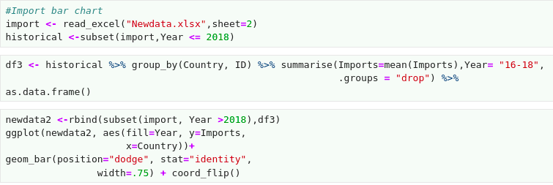
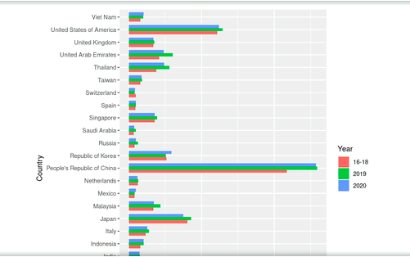
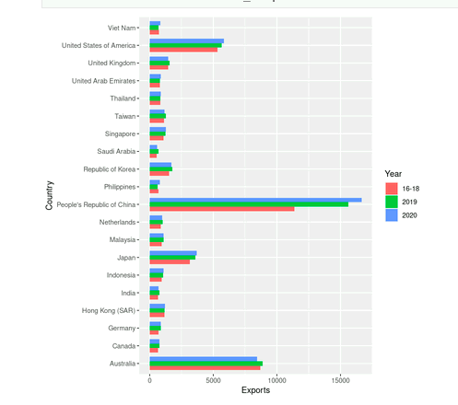
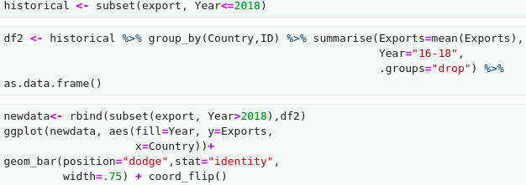
Export & Import by counties
Notes:
This diagram shows the countries that have the closely relationship with New Zealand during the 2016-2020. From the picture, we can clearly see that since the broke out of covid-19 hasn’t affected the trading volume with most of the countries, and surprisingly, China become New Zealand's largest mercantile partner.

Slide 20
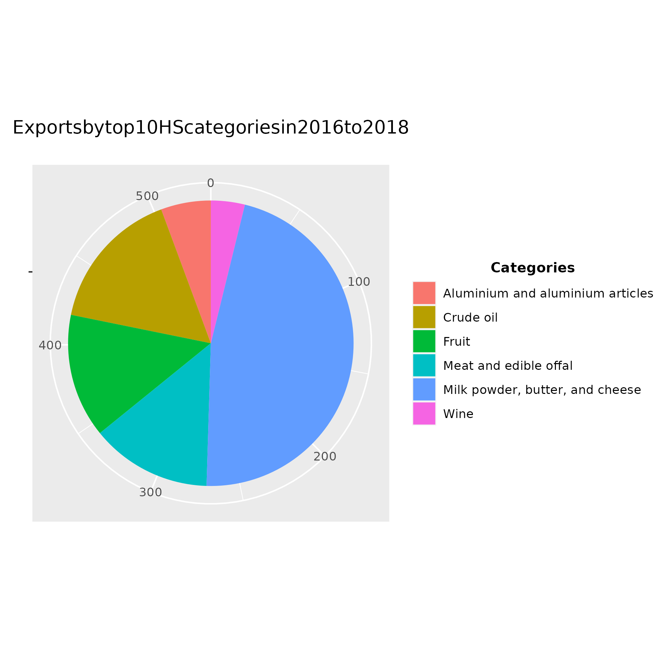
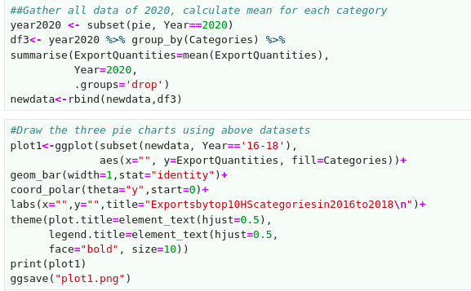

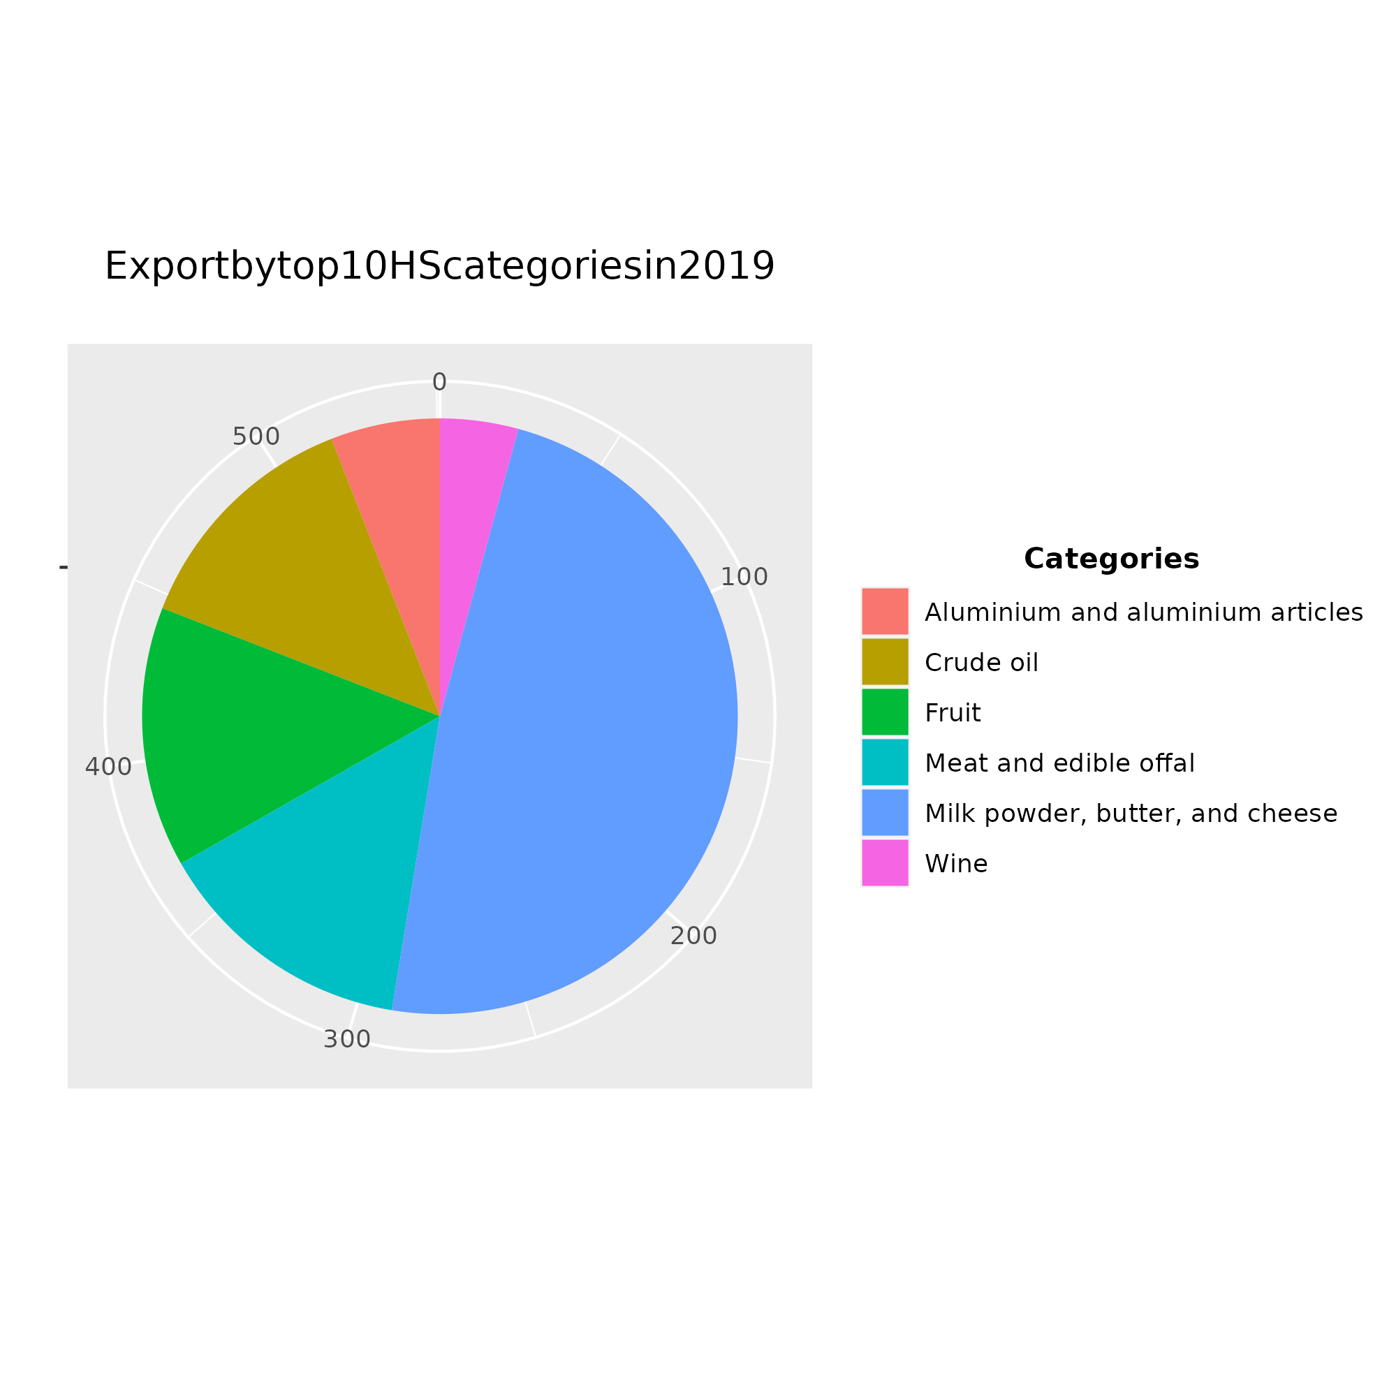
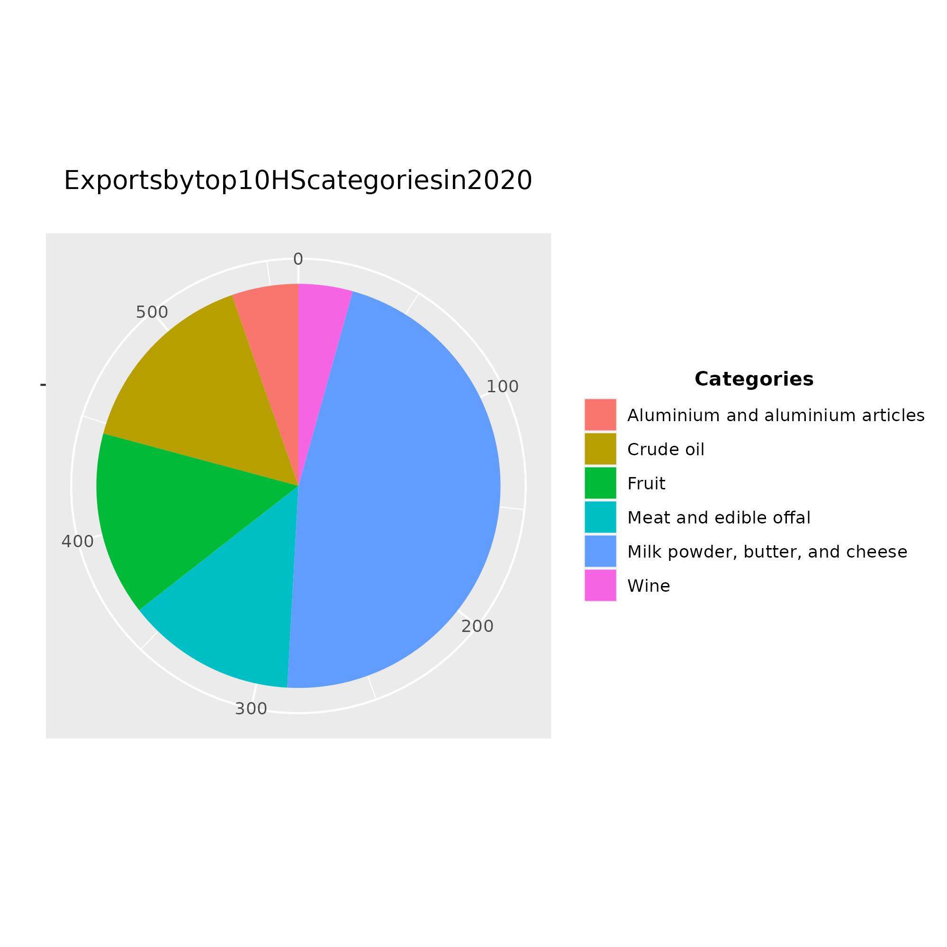
Top 10 Export categories by Harmonised System from Dec 2018 –June 2020
Notes:
In the last picture, I used pie charts to show the Top 10 export categories of New Zealand from 2018 to 2020. From the figure, it can we can noticed that the epidemic has not much impact on the quantities and variety of overseas merchandise trade.

Slide 21


Findings & reflections
Volume of import and export
Mercantile partnership
Export quantity and variety
Reasons for that:
Insufficient database
Policy changes
New Zealand as an agricultural producer country

Slide 22

Q&A

